Slide 1

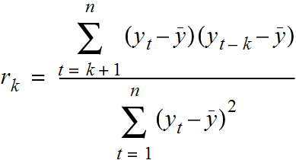



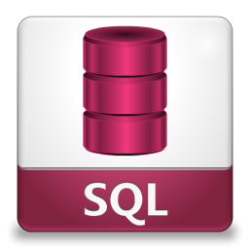









WHAT & WHY?
DATA SCIENCE INTRODUCTION

Slide 2
SETUP
GITBASH
https://git-scm.com/downloads
ANACONDA 2.7
https://www.continuum.io/downloads
SETUP A GITHUB PROFILE
https://github.com

Slide 3
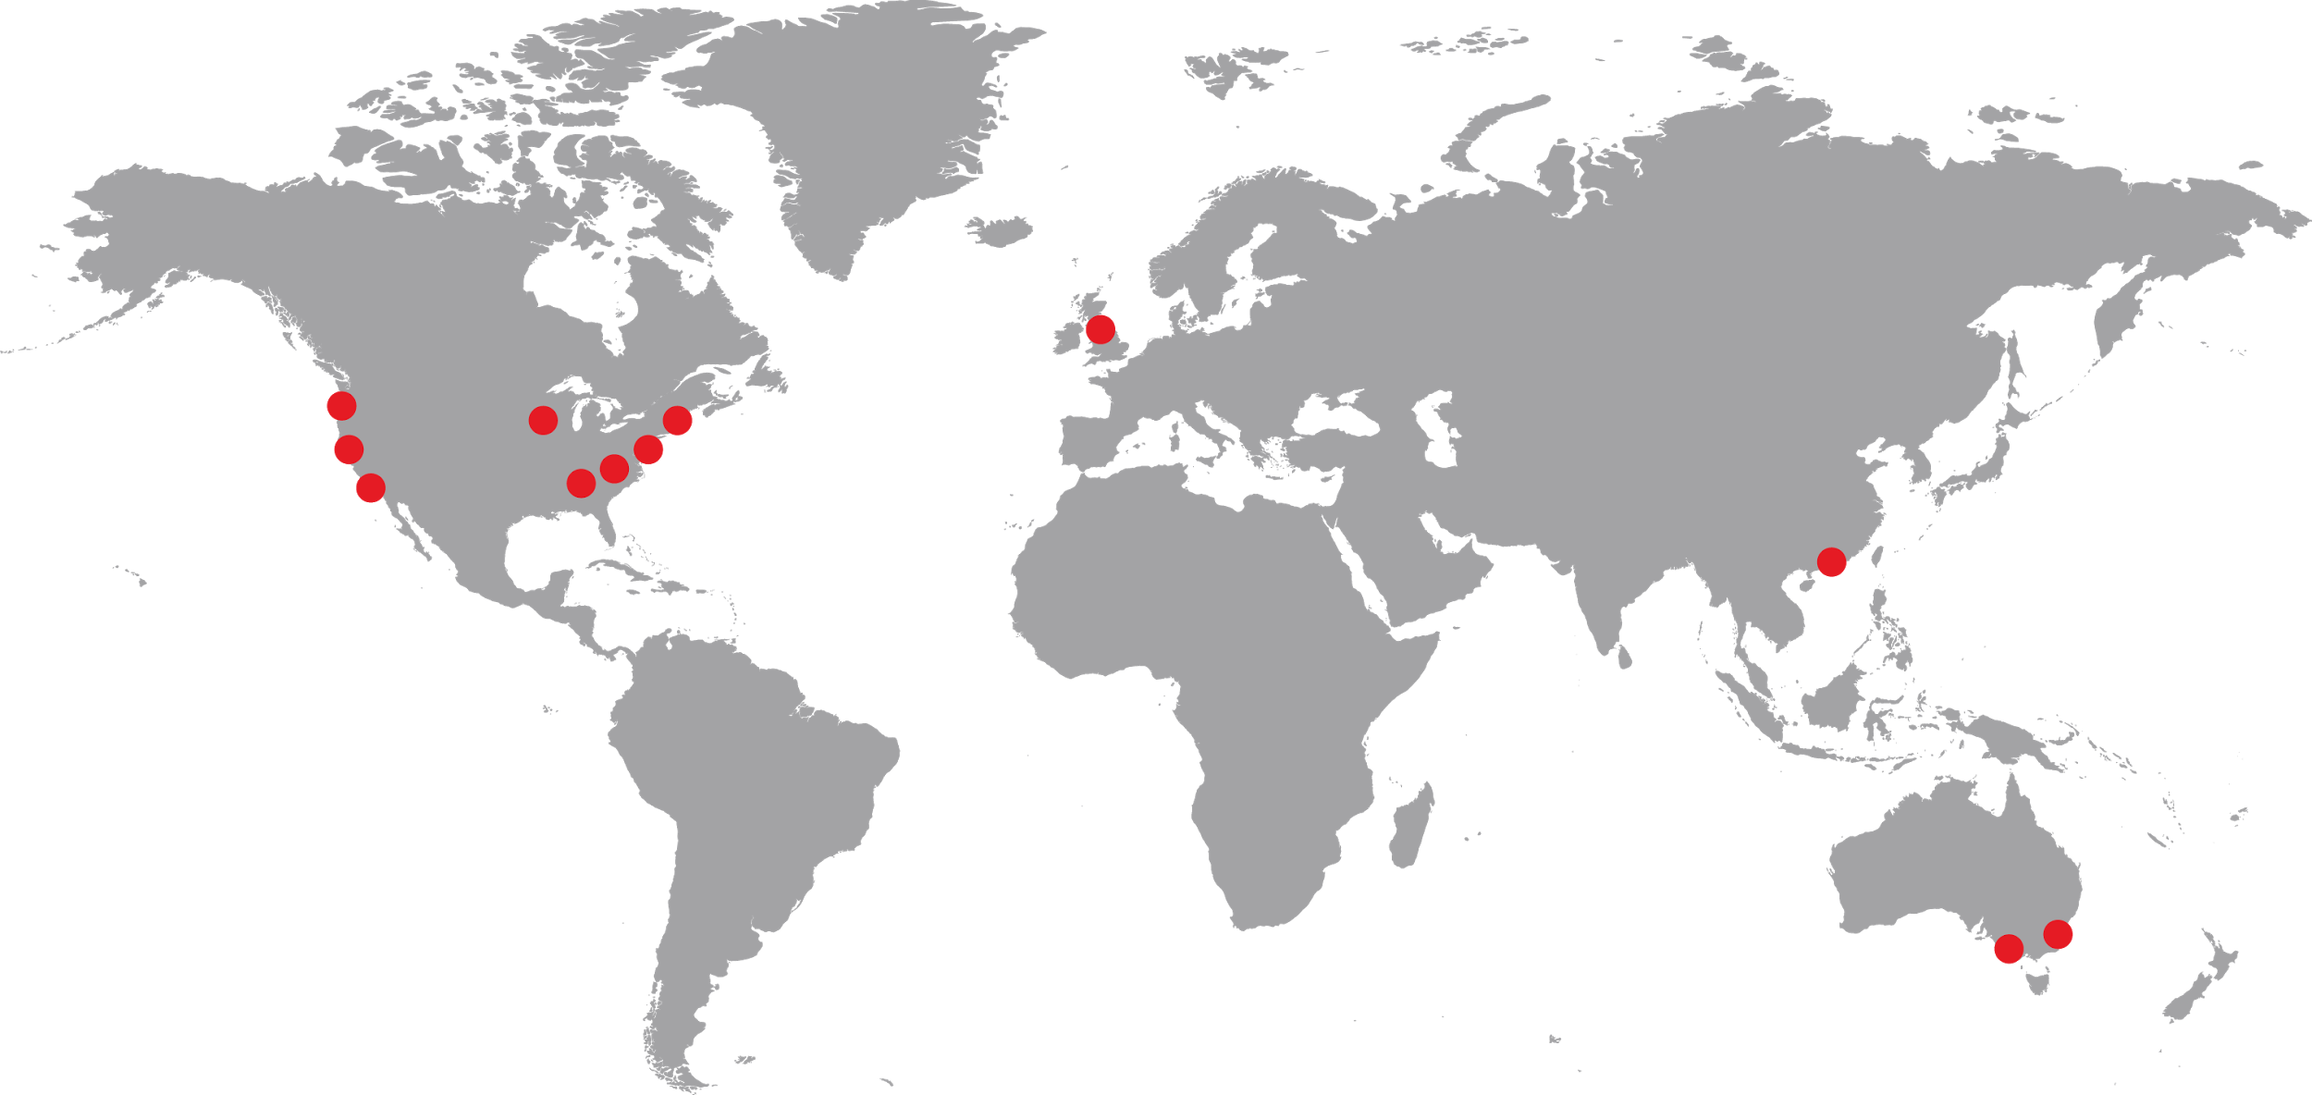
Notes:
General Assembly - “GA” - is a global education institution that specializes in the most in-demand skills across data, design, technology and business. We have campuses like this one in 14 other cities around the world, where we empower a global community to pursue work they love
We offer classes, workshops, and courses in development, design, digital marketing, data science, and business with a range of commitment options
As part of helping individuals like yourselves acquire new skills and/or transition into a new career, we also work with employers as a source of talent. In fact, more than 2500 employers have hired our grads of our full-time, immersive courses!

Slide 4


Matthew Morris Advanced Analytics Data Analyst, Costco
Data Analytics Course Instructor, General Assembly
CAREER PATH: Data Warehouseing, SQL & Analytics training, Accounting, HR, Merch Solutions, Advanced Analytics
General Assembly
Notes:
Tonight we’re joined by (instructor) who teaches in (course)
You also have probably already met (mentor) who’s an alumni of (course), who will be here to help you our with any issues you have during the workshop. Just flag (her/him) down. (NOT YET FULLY IMPLEMENTED)
As a final note before we get started, you will receive a follow up email after this workshop with:
All of our slides tonight and course information
A screencast of this lecture (NOT YET IMPLEMENTED)
The example we’ll work through together tonight
I’m going to hand things over to (instructor), who will give you some more info about his background…

Slide 5
INTRO TO DATA SCIENCE
WHAT IS DATA SCIENCE
AND WHY DO WE CARE?

Slide 6
BY THE END OF THIS YOU WILL BE ABLE TO
DESCRIBE THE ECOSYSTEM OF A DATA SCIENTIST
NAVIGATE FILE SYSTEM USING CMD
EXPLORE FILES USING BASIC PANDAS FUNCTIONS

Slide 7
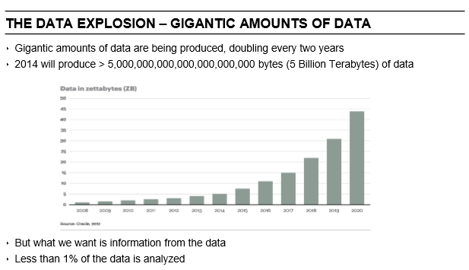

Slide 8
WHERE DOES DATA SCIENCE COME IN?
The world is full of situations where we want to:
Forecast likely outcomes given that we know now
Segment things into groups
Recommend something based on the likelihood it will be viewed or clicked on

Slide 9
EXAMPLES OF DATA SCIENCE IN ACTION
• Facebook facial recognition in photos
• Netflix/Amazon/Spotify recommendations
• Siri/Echo/Cortana voice recognition assistants
• Building art with Neural Networks - https://github.com/jcjohnson/neural-style
• Faceswap - https://www.youtube.com/watch?v=UngUWA43q5o
• Stock Market - https://www.quantopian.com/ - building crowd source hedge funds
• Helping people
https://www.drivendata.org/ - who is a good bet to give money to
http://www.datakind.org/projects
• Help find missing children - http://www.datakind.org/projects/finding-30000-missing-children
• Find correlations from sickness, grades, and attendance and try to find ways to improve them http://coolculture.org/webfm_send/62
• Additional examples https://www.kaggle.com/wiki/DataScienceUseCases

Slide 10
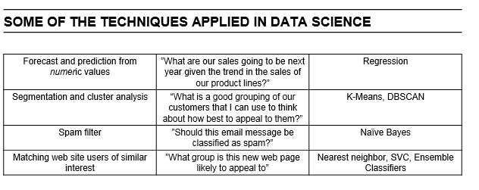

Slide 11
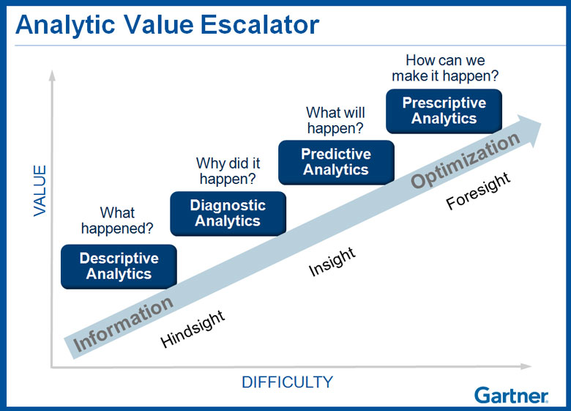
BASIC DEFINITIONS

Slide 12
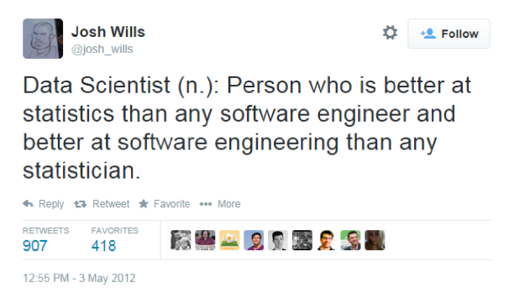

Slide 13
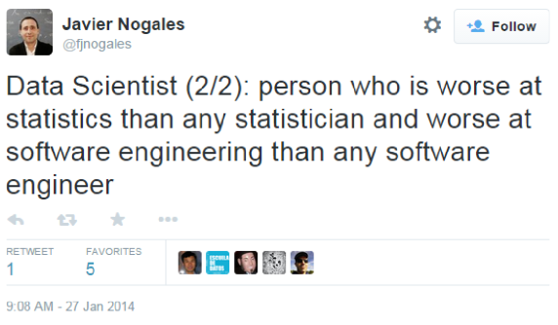

Slide 14
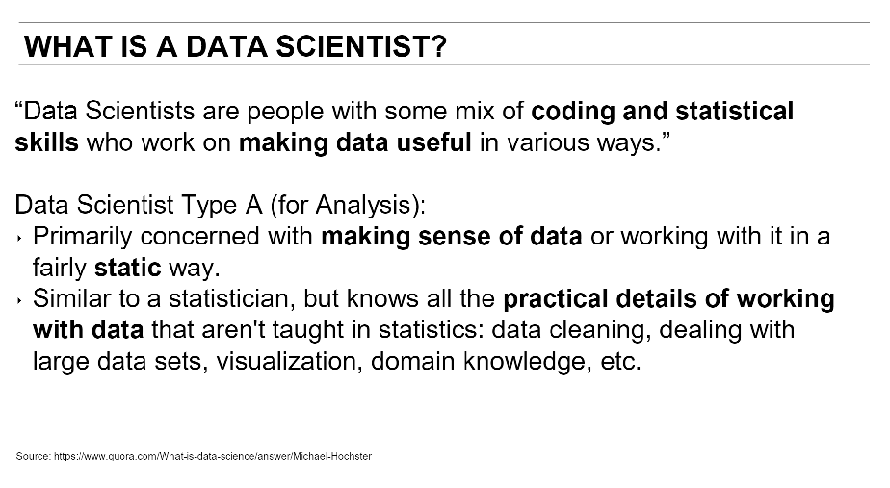

Slide 15
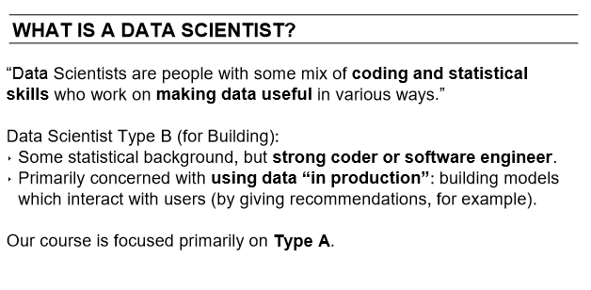

Slide 16
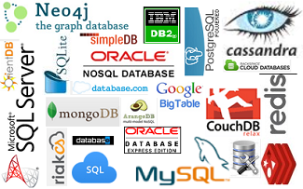
BASIC DEFINITIONS
Data storage, Understanding schemas, tables, fields, relational and non relational databases is a foundation of data analytics

Slide 17

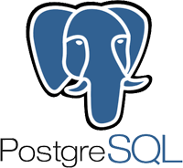
BASIC DEFINITIONS
Oracle express 11g edition/ Oracle SQL Developer
Postgres/Pgadmin4

Slide 18

BASIC DEFINITIONS
Business knowledge can include understanding: Knowing KPI’s, Gather requirements, MetaData, Operational reports, Business acumen, communication and navigating politics and personalities of your business culture
Having a strong understanding of Lookup functions, string and numeric functions is necessary to understand the business and how the currently tackle problems.
Basic Statistics(Central Tendency) Understanding concepts is fine. Understanding long hand even better.
This is a must to understand the basic charts and graphs and be able to tell a story with them.
Structured Query Language: Unless someone is getting all of your data for you and cleaning it all for you, you will want to be proficient in SQL up to Advanced levels.

Slide 19

BASIC CONCEPTS
Python is a general purpose programing language. Allows you to give directions to a computer to tell it what to do.
R is a system for statistical computation and graphics.
SAS SAS (Statistical Analysis System) is a software suite developed by SAS Institute for advanced analytics, multivariate analyses, business intelligence, data management, and predictive analytics.
SPSS Modeler IBM SPSS Modeler is a data mining and text analytics software application from IBM. It is used to build predictive models and conduct other analytic tasks

Slide 20



BASIC CONCEPTS
Jupyter Notebooks allows you to create and share documents that contain live code, equations, visualizations and explanatory text.
Plain text formatter that converts for use in html, used to create documentation within Jupyter
Purpose of git is to manage a project, or a set of files as they change over time. It allows for version control and collaboration.
Command line is a user interface to a computers operating system. It allows you to navigate, manipulate and analyze files, data and more.

Slide 21



Python Vs R
Notes:
There are a lot of pros and cons to both R and Python in the end if you are going to put something in Production use Python, if you are just exploring use R.
https://www.datacamp.com/community/tutorials/r-or-python-for-data-analysis#gs.CUzvgCs
Advice learn python first when you feel good with python learn R.

Slide 22
Training Path
Python
Statistics
CMD
Git
Excel
SQL
Tableau
SPSS
30
60
90
210
365

Slide 23
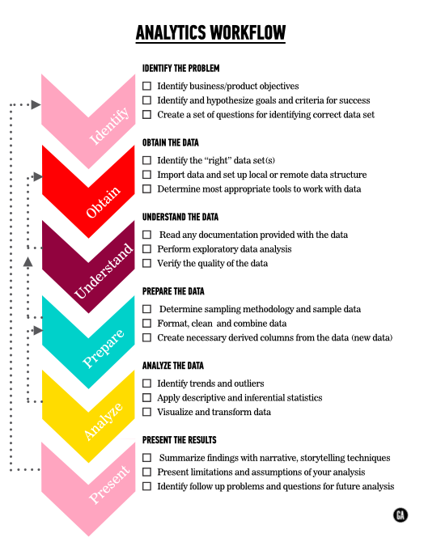

Slide 24
Data Science Workflow
Define feature vector matrix
Choose an estimator
Insatiate the estimator
Make a prediction
Evaluate the model

Slide 25











Reality of Workflows

Slide 26
AGILE

Slide 27







SETUP
ANACONDA
GITBASH

Slide 28
Moving data around and exploring
Set up Sandbox using CMD
Pull data using git
Review data using CMD
Explore data using Python
Basic concepts of predictive models

Slide 29
SET UP SANDBOX USING CMDLINE
pwd Present working directory
ls- list files directories and subdirectories
cd Change directory
cd path/ Change directory and path name
mkdir- make a new directory
Git init – initialize new git repository
Exercise
Make a new directory on your desktop called Sandbox
In Sandbox make another directory called Dsintro
Notes:
Basic commands Actions pwd present working directory ls lists files and subdirectories in your working directory ls -a lists all files, including hidden files ls -l lists the files in a long format with extra information (permissions, size, last modified date, etc.) ls * also lists the contents of subdirectories (one level deep) in your working directory ls<path> lists files in a specific directory (without changing your working directory) clear clears all output from your console cd moves you to your "home" directory cd<path> changes directory to the path you specify, which can be a relative path or an absolute path cd.. moves you "up" one directory (to the parent directory) mkdir<dirname> makes a new directory called <dirname> touch creates an empty file called <filename>, This is useful for creating empty files to be edited at a later time. touch <filename1> <filename2> <filename3> ... Multiple empty files rm<filename> removes file or deletes it permanently rm-i<filename> removes files in interactive mode, in which you are prompted to confirm that you really want to delete the file. It's best to always use rm -i. rmdir<dirname> rmdir <dirname> removes a directory and recursively deletes all of its contents mv<filename><new path> moves file from its current location to <new path> use this as well to rename a file cp<filename><new path> copies fa file from it's current location to <new path>, leaving the original file unchanged.

Slide 30
PULL DATA USING GIT
git pull https://github.com/Morrisdata/DataScience101.git
What just happened and why do you care?
head<filename>
prints the head (the first 10 lines) of the file
head -n20 <filename>
prints the first 20 lines of the file
tail <filename>
prints the tail (the last 10 lines) of the file

Slide 31
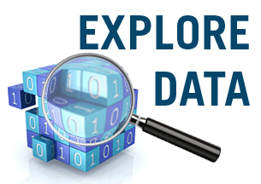
EXPLORE DATA USING PYTHON
Notes:
#Import libraries
import pandas as pd
import matplotlib.pyplot as plt
# increase default figure and font sizes for easier viewing
plt.rcParams['figure.figsize'] = (8, 6)
plt.rcParams['font.size'] = 14
# read in the drinks data
drinks = pd.read_csv('~/Desktop/DataScience/drinks.csv')
#EXPLORE DATA
drinks.dtypes # data types of each column
drinks # print the first 30 and last 30 rows
type(drinks) # DataFrame
drinks.head() # print the first 5 rows
drinks.head(10) # print the first 10 rows
drinks.tail() # print the last 5 rows
drinks.index # "the index" (aka "the labels")
drinks.columns # column names (which is "an index")
drinks.shape # number of rows and columns
drinks.values #
# ## Bar Plot: show a numerical comparison across different categories
# count the number of countries in each continent
drinks.continent.value_counts()
# compare with bar plot
drinks.continent.value_counts().plot(kind='bar')
# calculate the mean alcohol amounts for each continent
drinks.groupby('continent').mean()
# side-by-side bar plots
drinks.groupby('continent').mean().plot(kind='bar')
# drop the liters column
drinks.groupby('continent').mean().drop('total_litres_of_pure_alcohol', axis=1).plot(kind='bar')
# stacked bar plots
drinks.groupby('continent').mean().drop('total_litres_of_pure_alcohol', axis=1).plot(kind='bar', stacked=True)

Slide 32

Training Path
Notes:
http://scikit-learn.org/stable/tutorial/machine_learning_map/

Slide 33
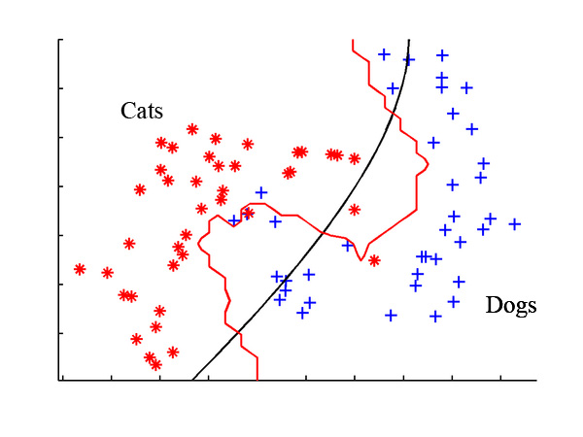
Classification
Notes:
Likely-hood something is in a category

Slide 34
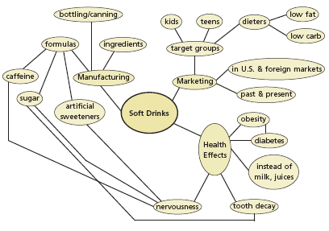
Clustering
Notes:
How one thing leads to another

Slide 35
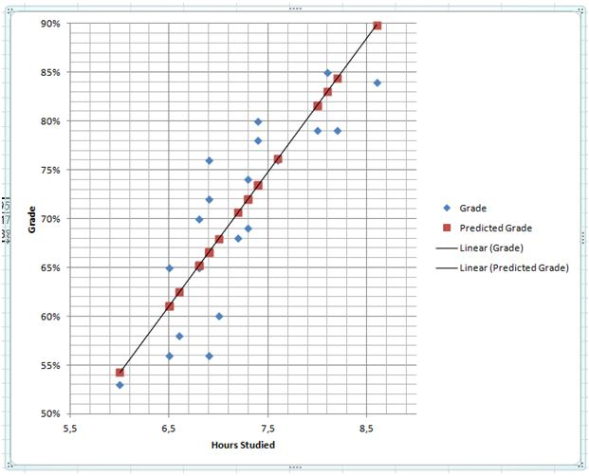
Regression
Notes:
http://scikit-learn.org/stable/tutorial/machine_learning_map/

Slide 36
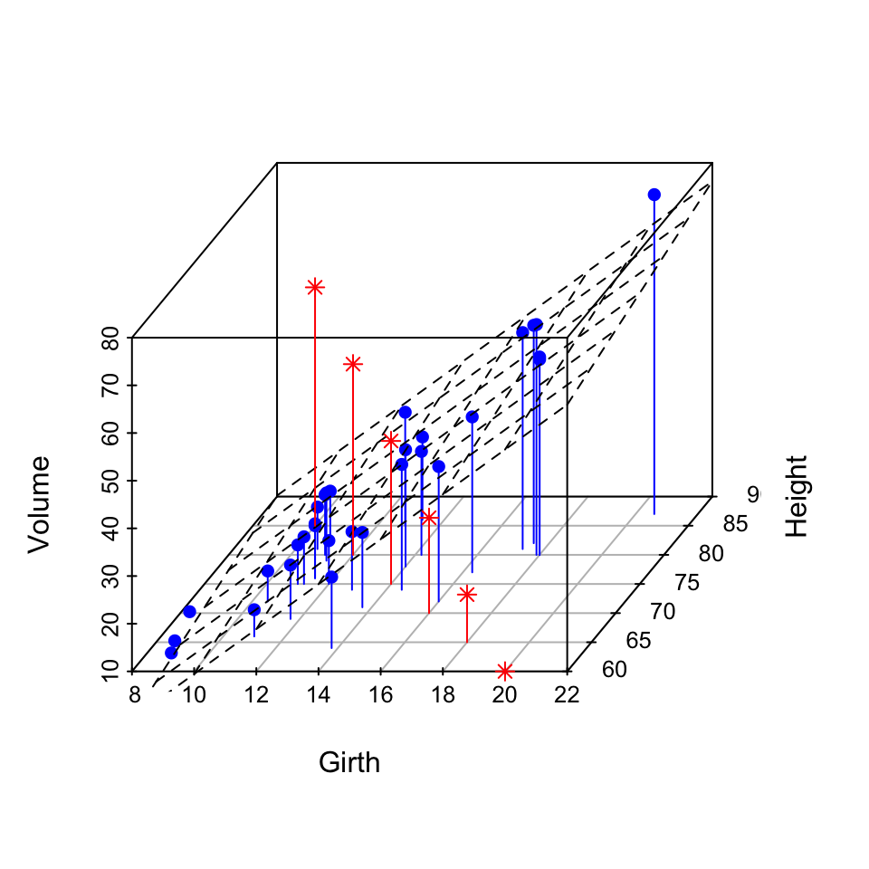
Dimensionality Reduction
Notes:
In machine learning and statistics, dimensionality reduction or dimension reduction is the process ofreducing the number of random variables under consideration, via obtaining a set of principal variables. It can be divided into feature selection and feature extraction

Slide 37
WHAT DID WE JUST DO?
Set up Sandbox using command line
Pull data using git
Review data using cmd
Explore data using Python
Basic concepts of predictive models

Slide 38
